Slide 1
How to close the library for a specified or non-specified period of time using the Alma Calendar Management
Yoel Kortick
Senior Librarian

Slide 2
Introduction
The background of what we will configure
The configuration
See the exception in the libraries
See what happens if loan will be due when library is closed
Disabling the library closure

Slide 3
Introduction

Slide 4
Introduction
There are situations whereby due to unexpected circumstances an institution may need to close the library for a specified or non specified amount of time.
That will be the focus of this presentation.

Slide 5
Introduction
For general information about editing library opening and closing times see:
For editing library open and close times manually: Configuring Institution/Library Open Hours
For editing library open and close times by uploading an Excel Sheet: How to update library opening hours via an Excel file upload
For editing library open and close times via an API: Implementing the Alma Library Open Hours API

Slide 6
Introduction
In the example here we will make the change on the level of the institution and it will thereby effect all libraries of the institution.
It is of course possible to also do this on the level of one or more libraries separately.

Slide 7
The background of what we will configure

Slide 8
The background of what we will configure
There are three types of entries in the Alma calendar:
Opening Hours: Opening hours of the standard schedule. Every library has a set of defaults with one entry per weekday. This is not inherited from institution to library
Exceptions: Temporary changes to the standard schedule. It might be for example a holiday or extended opening hours during the exam period. It can be a single date or a date range. This is inherited from institution to library.
Events: These display in the calendar but do not affect open/closed status. This is inherited from institution to library.

Slide 9
The background of what we will configure
Because events
Are inherited from the institution to the library
Do effect library opening hours
we will create an event in the institution for the period of time in which the institution will be closed.
It will effect the opening hours and be inherited by all libraries.
If desired we could instead create one or more events in the specific libraries

Slide 10
The configuration

Slide 11

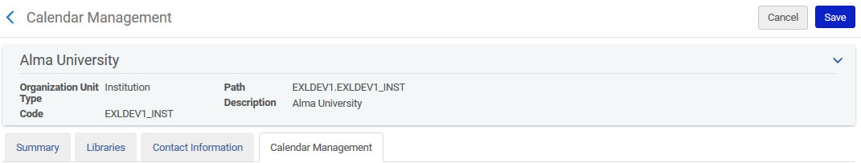
The configuration
Navigate to Configuration > Configure for Institution
“Alma University” is the institution name
General > Libraries > Add a Library or Edit Library Information > Calendar Management tab.

Slide 12
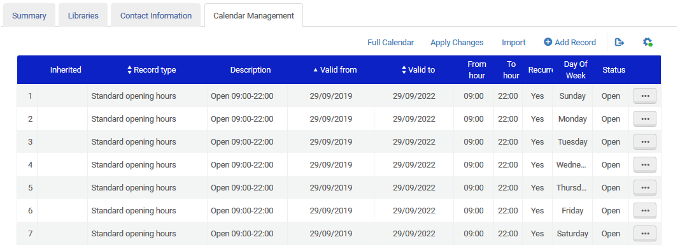
The configuration
We see the calendar

Slide 13
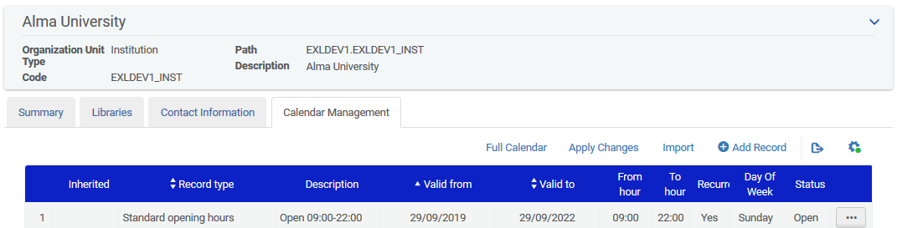
The configuration
We will now add a record to the calendar

Slide 14
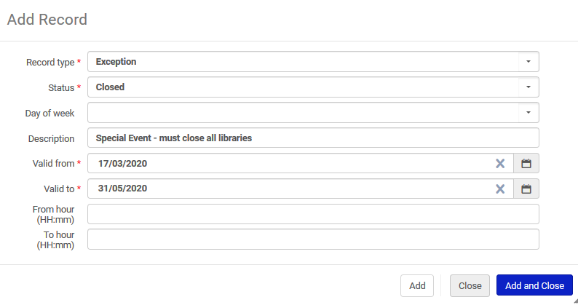
The configuration
The record type will be “exception” and the status will be “closed”
Valid March 17th to May 31 2020

Slide 15
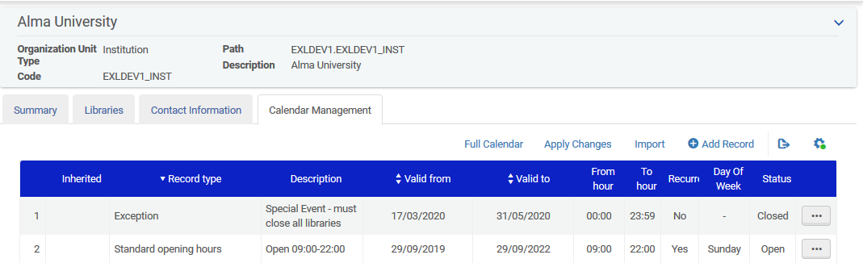
The configuration
After adding the exception click “Apply Changes”
A job will run to apply the calendar changes (this may take a few minutes)

Slide 16
See the exception in the libraries

Slide 17
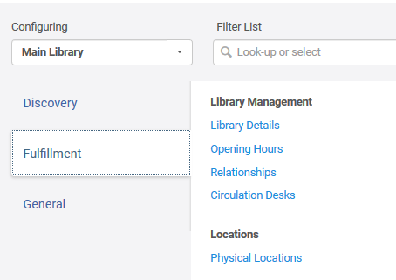
See the exception in the libraries
If we now look at the opening hours for one of the libraries …

Slide 18
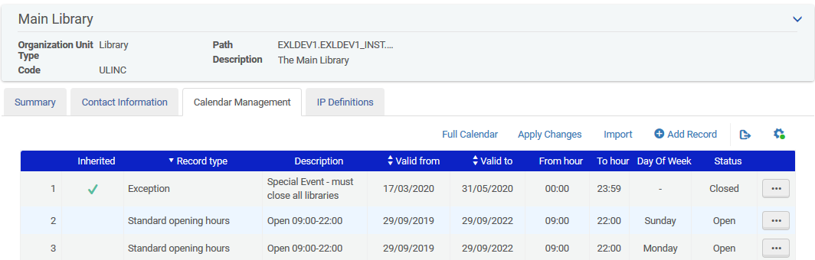
See the exception in the libraries
We see the exception inherited from the institution

Slide 19
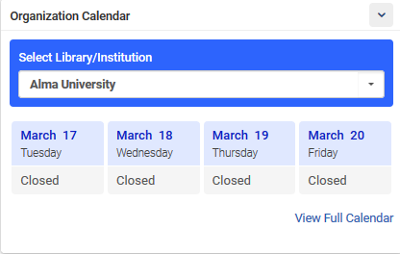
See the exception in the libraries
The organization calendar shows the institution closed on the specified days

Slide 20
See what happens if loan will be due when library is closed

Slide 21
See what happens if loan will be due when library is closed
In the loan rule terms of use it is possible to define that if a due date will fall on a closed day then the due date will move to the end of the next open day
Note that if a loan’s policy is ‘keep due date’ the due date for it will not change following a calendar update
Note that for the existing loans to get the modified due date, the scheduled job: ‘Loans - Due Date Correction after Calendar Change’ needs to run

Slide 22
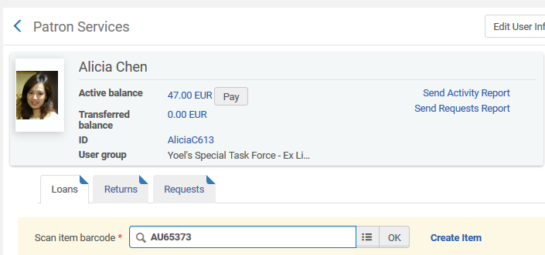
See what happens if loan will be due when library is closed
So for example we will loan item barcode AU65373 to patron Alicia Chen (even though when the library is closed there probably will not be loans made, we are doing this to test that the library really is “closed”)

Slide 23
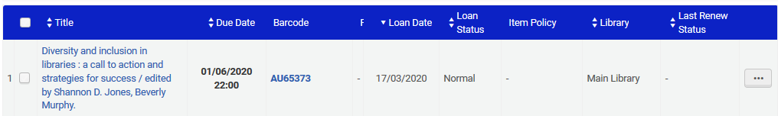
See what happens if loan will be due when library is closed
The item is due on the next open day. Our exception states that the library is closed from March 17th to May 31, 2020. The item is due June 1, 2020 (which is the next open day)

Slide 24
Disabling the library closure

Slide 25
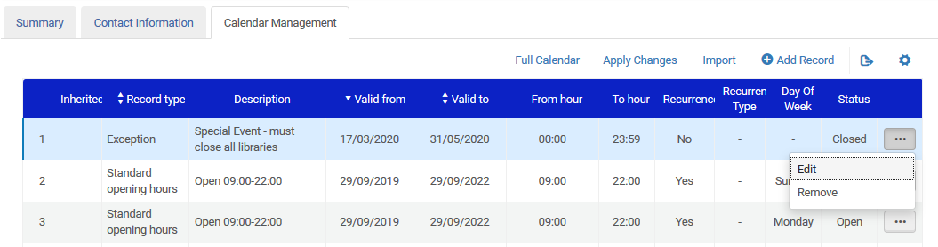
Disabling the library closure
If the institution reopens on June 1, 2020 then there is nothing to do. There is no need to “disable” the closure, because the closure period has passed.
If however the library unexpectedly reopens then the institution merely needs to remove the exception (and then click “apply changes”)
This will not update existing loans’ due dates but new loans will behave according to the updated opening times

Slide 26
Thank you!
xxx@exlibrisgroup.com

